Slide 1

Assistive Vision for
Visually Impaired
Submitted by:
Guneet Pal Singh(028/CSE1/2017)
Gurkirat Singh(032/CSE1/2017)
Harjot Singh Saggu(036/CSE1/2017)
Karandeep Singh Ater(058/CSE1/2017)
Under the guidance of:
Ms. Jasleen Ma'am
Department of Computer Science & Engineering
Guru Tegh Bahadur Institute of Technology

Slide 2
Assistive Vision
Introduction
Features
Approach
Industrial use
Test cases
References

Slide 3
Introduction
Even with the rise of tools and technologies, mankind hasn’t implemented applications that could help visually impaired people. With the rise of Data Modelling techniques that can be used to infuse “intelligence” even in dumb computers and the ease of accessibility, this “intelligence” can be extended to our Smartphone to help the visually impaired people cope up with their surroundings and get a helping hand in their daily activities.
Our Application aims to bridge the gap between them and the visual world by leveraging the power of Deep Learning which can be made accessible even on low-ended devices with a lucid User-Interface that would exactly allow them to better understand the world around.

Slide 4
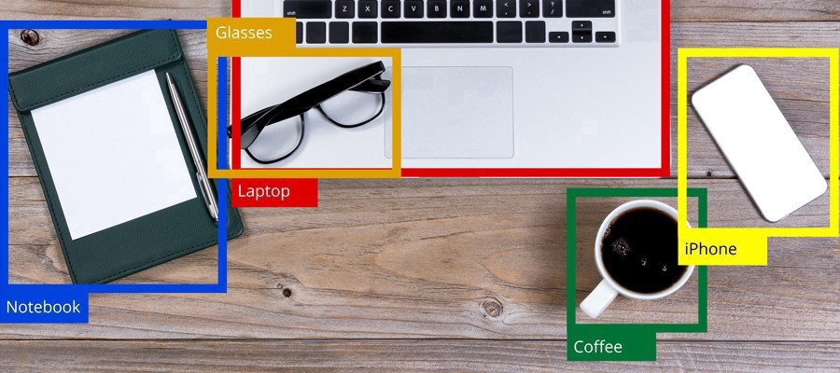
Features
Object Detection in Realtime
Live Image Labelling is one of the features that capitalize on Tensorflow, Google's Machine Learning Framework that has been designed to develop and serve models even on Low-Ended Devices like Smartphones. To make this possible we are capitalizing on the capability of Transfer Learning to develop the Models real quick and to get an appreciable Performance Metric even in the lacking support for high-ended devices.

Slide 5

Currency Detection
Our application allows user to detect currency notes as well
We have used a custom trained tflite model trained on Indian currency. This model can be trained on more data to detect currencies of other countries as well.

Slide 6
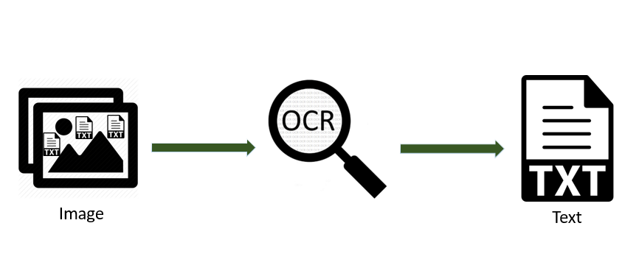
Text Extraction from images
Users might sometimes need to read text present in a photo they clicked, or have saved in their gallery. Being visually impaired, it might not be easy for them to properly read the text. So we have provided a feature for users to click a photo, select existing photos, and extract all the text from them. This text is them spoken out to the user using our text-to-speech functionality.

Slide 7




Technologies Used:

Slide 8
Industrial Use
Our primary purpose behind this project is to leverage and study how Deep Learning Architectures along with easy prototyping tools can help us develop applications that can be easily rendered even on low-end devices.
With this Application, we will develop a one-stop solution to allow the Blind or Partially Blind People to better understand the surroundings around them and to be able to cope with the dynamic world ahead of them.

Slide 9
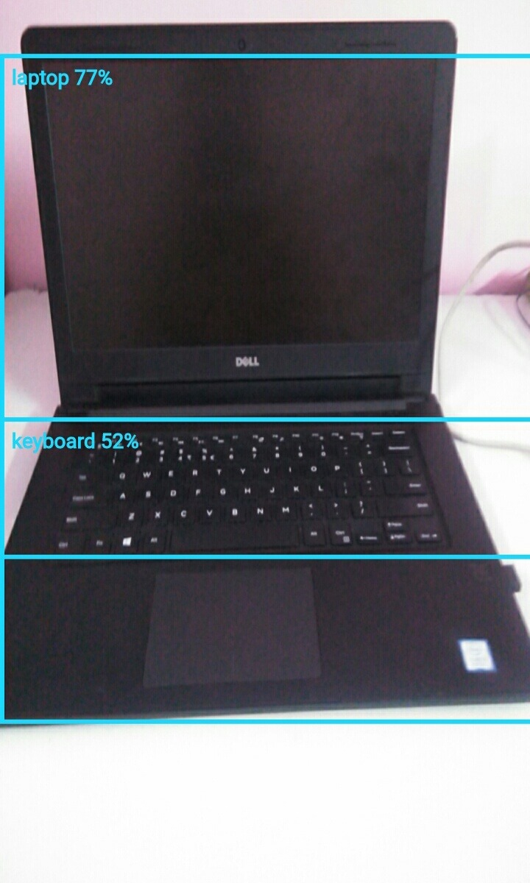
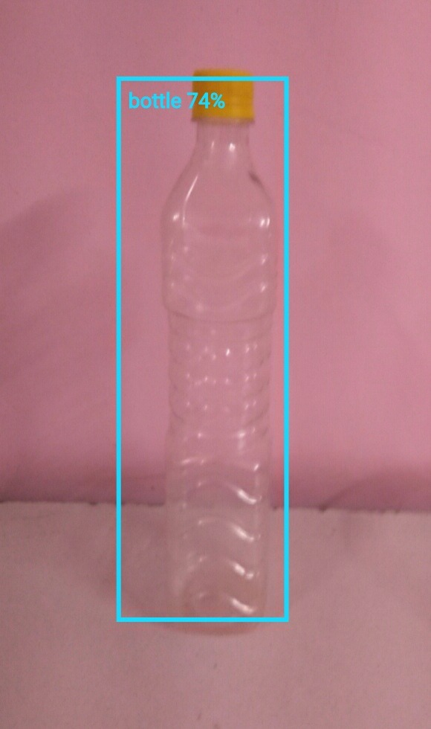
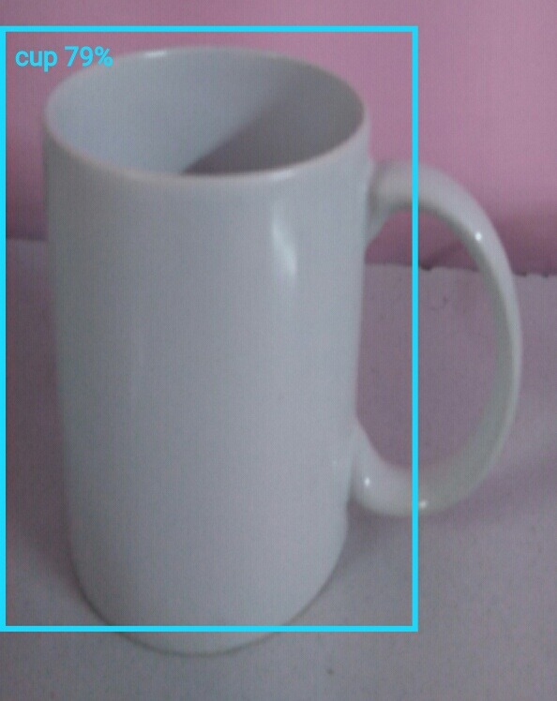
Test cases:
Live Image Labelling

Slide 10
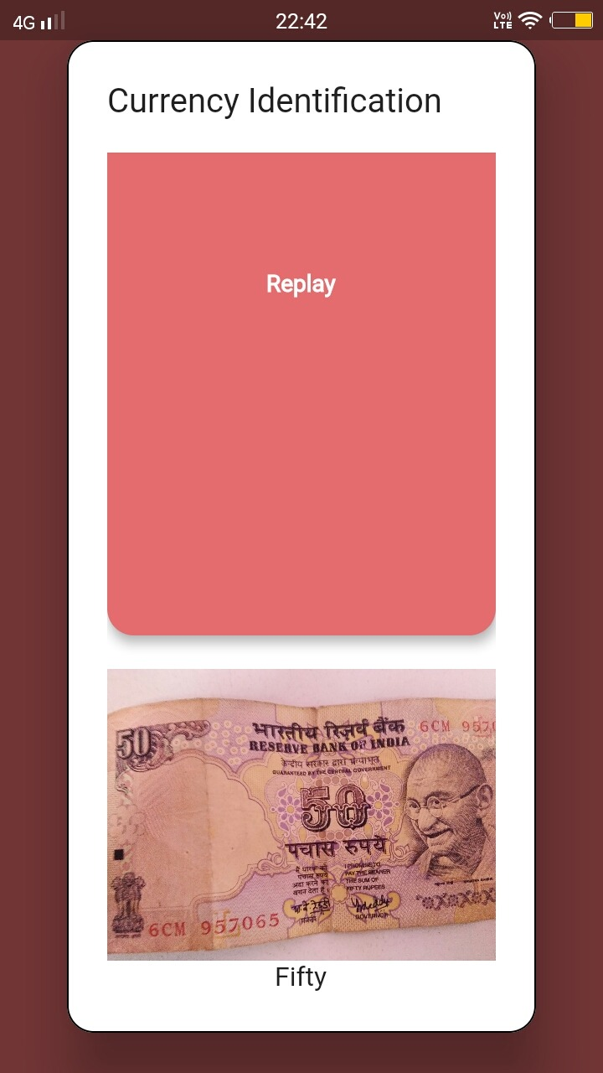

Currency Identifier
Text Extraction

Slide 11
References
[1] Local binary patterns: Application to face recognition. Trans. Pattern Anal. Mach. Intell., 28(12):2037–2041, 2006. T. Ahonen, A. Hadid, and M. Pietikainen. Face description
[2] S. Baluja and H. A. Rowley. Boosting sex identification performance. Int. J. Comput. Vision, 71(1):111–119, 2007.
[3] A. Bar-Hillel, T. Hertz, N. Shental, and D.Weinshall. Learning distance functions using equivalence relations. In Int. Conf. Mach. Learning, volume 3, pages 11–18, 2003.
[4] W.-L. Chao, J.-Z. Liu, and J.-J. Ding. Facial age estimation based on label-sensitive learning and age-oriented regression. Pattern Recognition, 46(3):628–641, 2013. 1, 2
[5] K. Chatfield, K. Simonyan, A. Vedaldi, and A. Zisserman. Return of the devil in the details: Delving deep into convolutional nets. arXiv preprint arXiv:1405.3531, 2014.
[6] J. Chen, S. Shan, C. He, G. Zhao, M. Pietikainen, X. Chen,and W. Gao. Wld: A robust local image descriptor. Trans.
Pattern Anal. Mach. Intell., 32(9):1705–1720, 2010.
[7] S. E. Choi, Y. J. Lee, S. J. Lee, K. R. Park, and J. Kim. Age estimation using a hierarchical classifier based on global and local facial features. Pattern Recognition, 44(6):1262–1281, 2011.
[8] T. F. Cootes, G. J. Edwards, and C. J. Taylor. Active appearance models. In European Conf. Comput. Vision, pages 484–498. Springer, 1998.
[9] C. Cortes and V. Vapnik. Support-vector networks. Machine learning, 20(3):273–297, 1995.
[10] E. Eidinger, R. Enbar, and T. Hassner. Age and gender estimation of unfiltered faces. Trans. on Inform. Forensics and Security, 9(12), 2014. 1, 2, 5, 6

Slide 12
THANK YOU

